Slide 1
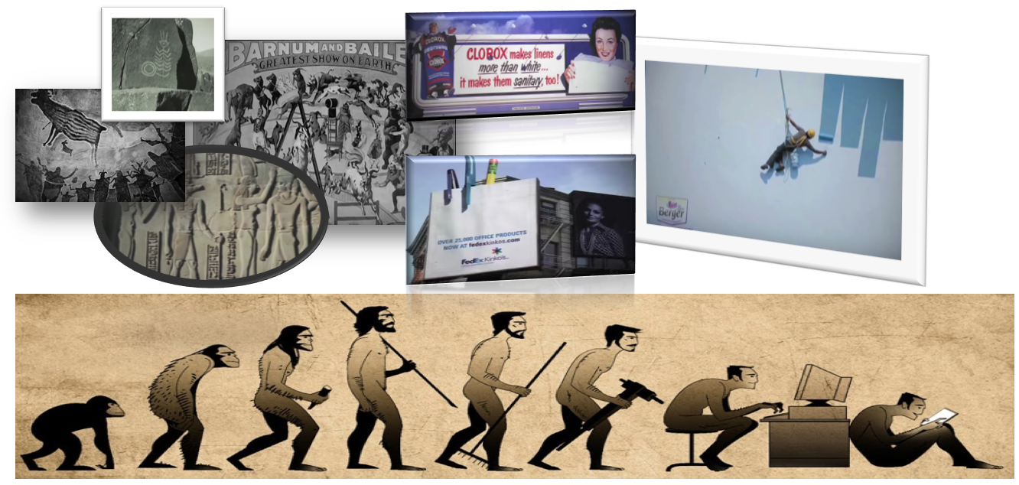
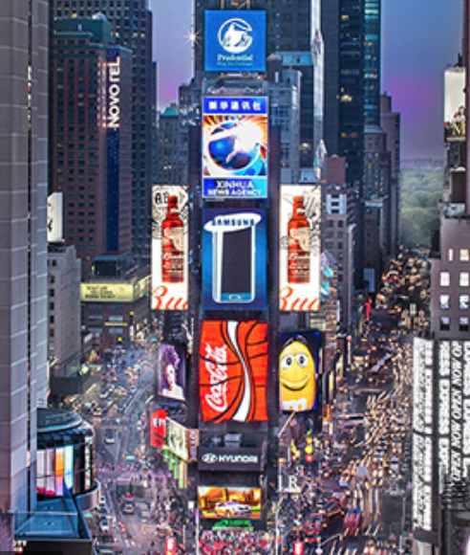

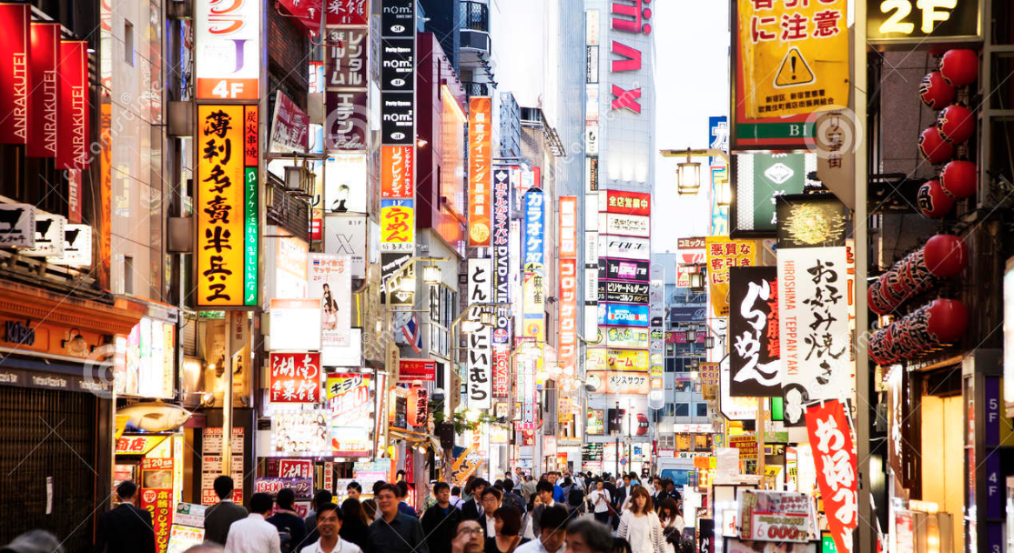
#1: Since the beginning of time…
Undeniable evidence of impact of advertising in driving branding campaigns
Out of Home (OOH) advertising has been the most impactful, as a medium for lasting visual outreach
The modern age mantra is dynamic digital billboards
As humans progressed, our medium of data absorption evolved but our unrelenting need for it, persisted.
The big question for brands is how to stand out and reach their target customer base, in this clutter of visual overload
Voiceover: Since the beginning of human evolution, outdoor advertising has had an astounding impact on branding. It is still considered as the most impactful medium for visual outreach. Prime example being modern cityscapes plastered with billboard advertisements, each fighting to grab a lasting memory amongst viewers. From the digital billboards at Times Square attracting 50 million tourist annually, to the 30 million plus tourists going to see the neon city of Tokyo, there is something to be said about its impact and outreach.
The big question still haunts big brands: how to maximize on advertisements?

Slide 2

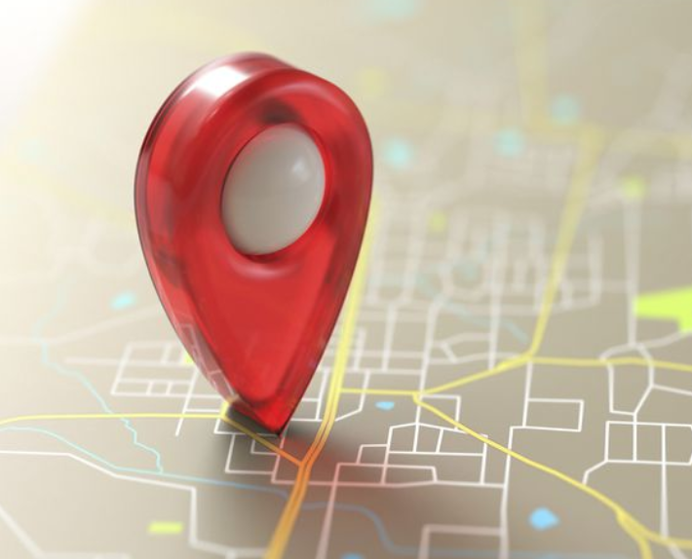

#2: Current challenges and Ogilvy’s solution
Whom to advertise to?
Target consumer demographics
Commute behavior leading to pattern based clustering
Parameters like income, spending habits, product category, etc can help narrow down on the target consumer
Where and when to advertise?
A need to pin-point key locations with highest visibility and presence of digital billboards
Pinpoint the congestion points in commute and/or stops for the target consumers
How to maximize impact through visual exposure?
CREATIVITE LICENSE > Ogilvy already has this tackled > industry expertise in marketing and branding. Award winning ad campaigns in utilitarian achievements, even in physical ad-spaces beyond mere 2D billboard format
Voiceover: The major challenge that a company faces in outdoor advertisement, is to be able to successfully map the ROI from it.
The solution provider can be Ogilvy. Ogilvy already has award winning ad- campaigns like IBM and British Airways, which did dynamic and utilitarian marketing. Our marketing team already provides real time ROI on advertisement campaigns undertaken, with MMM modeling and tracking. What if, we can not only provide ROI of ad-campaigns but put forward a more holistic approach to it? ROI and a promise of improving ROI over a period of time?
How do we guarantee improvement in ROI?
We find out the target audience. We analyze their commute behavior to cluster them based on the time of their out of home availability, in other words, when, how often and for how long are they outside viz a viz in physical range of the advertisement. (maybe provide an example of commute pattern of a mid level executive).
We then proceed to map their commute to identify congestion points and time, when they are most susceptible for maximum visual exposure from the ads.

Slide 3


#3: How to attain maximum ROI
Sync up left and right side of the organization
A flow of information between the two can help in narrowing down focus on consumer behavior
Behavioral study of targeted consumers will positively affect sales for the client company, which translates to improving ROI of advertising
Analytics
Marketing
commute data indicative of commute path and time
congestion points
Track ROI based on sales number > indicating periodic performance
key consumer parameters
customer segmentation
Map ROI through MMM modeling
Voiceover: We need to run our marketing in tandem with analytics. Combining the right and left brain of the organization, we can achieve a new heights in model data powered marketing campaign. A handshake between these two sync up data analytics with marketing analytics : powerful data driven solution.
Save company money by targeting time based advertising > data driven time slot identification for the a focused target audience . Few further points to consider would be consumer income rage, past purchase behavior, residence location, etc.
Iterate the process based on past ROIs to fine tune the ad content and display> improvement in ROI

Slide 4
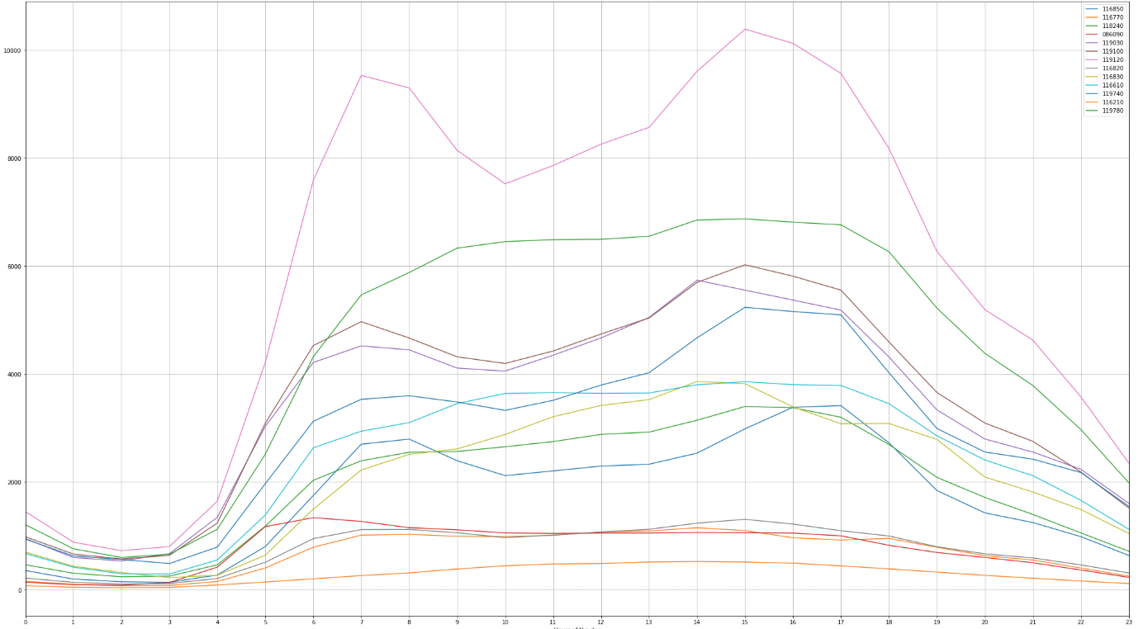
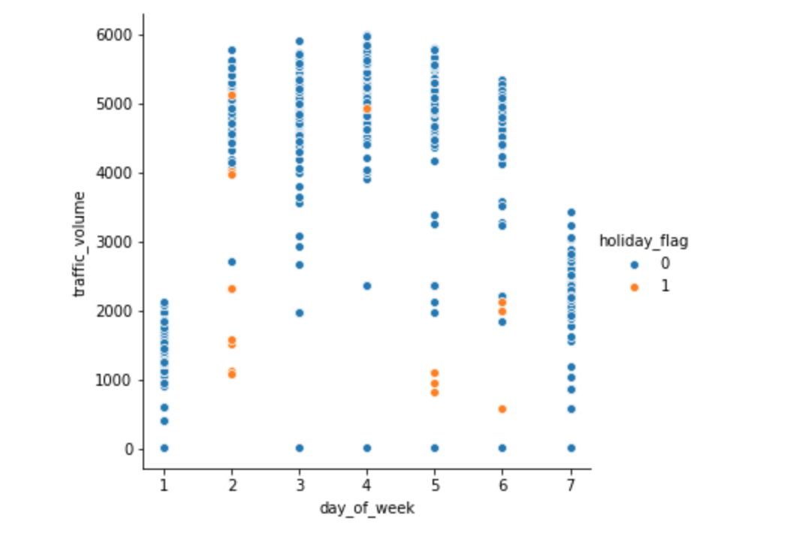
#4: what does the data say so far?
An hourly indication of traffic by volume of cars in Manhattan
Traffic peaks around 4 am and 3 pm
Midday traffic is comparatively less but still significant
Traffic volume is least in 11pm - 4am bracket
Time in 24 hr format
Traffic volume by day of week, indicates
Maximum traffic on Wednesday
Saturday has moderate traffic, could be significant for advertising purpose
Voiceover: Analyzing traffic patterns on a daily and weekly basis, provides us a basis of timing which can utilized by marketing departing to design ad campaign targeting Manhattan. Further in-depth analysis can highlight trends and patterns that can contribute to a successful campaign, either by dictating the ad content or by supporting it.

Slide 5

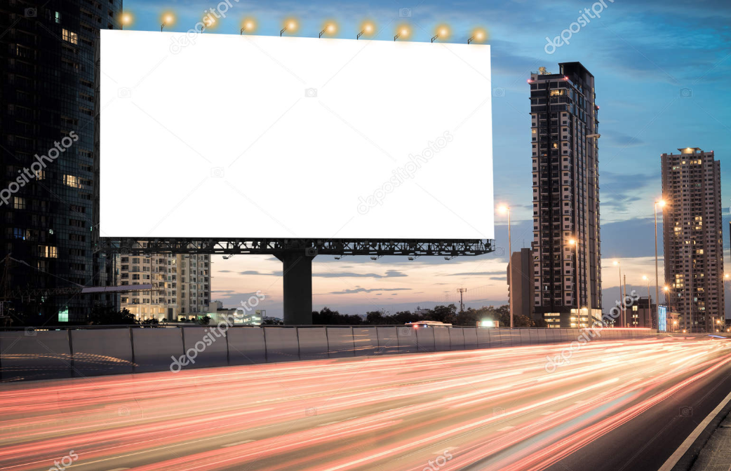


#5: How to interpret the data?
BILLBOARDS
AIN’T NOBODY GOT TIME FO DAT
Voiceover: Couple data insights to consumer behavioral studies, it suddenly has the capacity to hit bulls eyes. Let’s take an example, there is data evidence of high traffic volume at mid morning (i.e. 10-11 am), as well as late evenings – 6-8 pm. How do we now decide when to advertise?
Consumer behavior suggests that they would be more susceptible in the evening (they are relaxed after a day’s work and are not rushing into meetings), rather than in the morning (when they are focused on their emails and meetings for the day).
Critical insights like these can only come into play when both our departments have an open channel of information flow- a symbiotic relationship that both can benefit from.

Slide 6
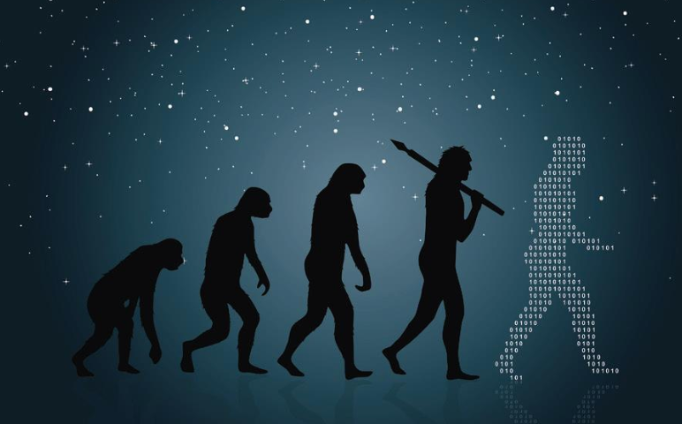

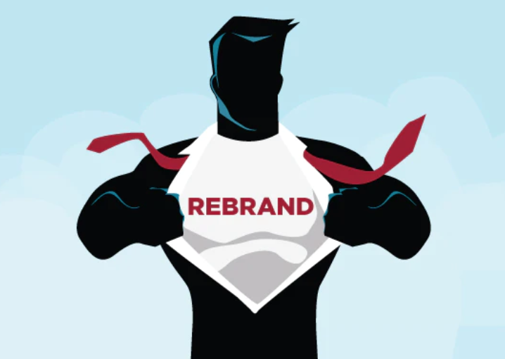

#6: Let’s Evolve
Voiceover: let’s step into next phase of evolution. Rebrand ourselves into a advertising and marketing mogul with the superpower of data analytics
Act now and let’s transcend from bare information to empowerment through knowledge. Afterall, knowledge is power.
Please let us know what you think.

